Slide 1
AI SPM Roundup
David Strom
9/24

Slide 2
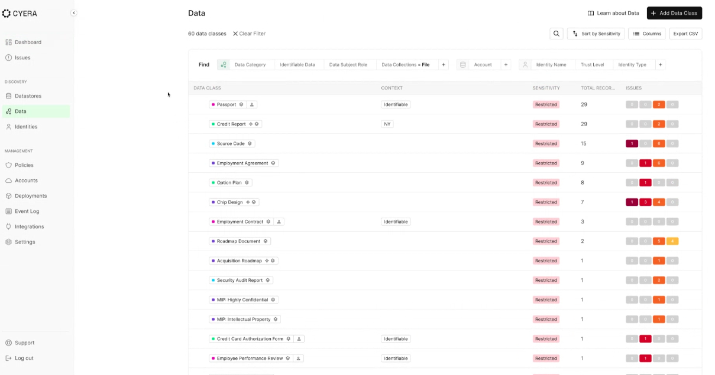
Notes:
Cyera excels in its data classification routines, where you can quickly identify potential misuse and threats.

Slide 3
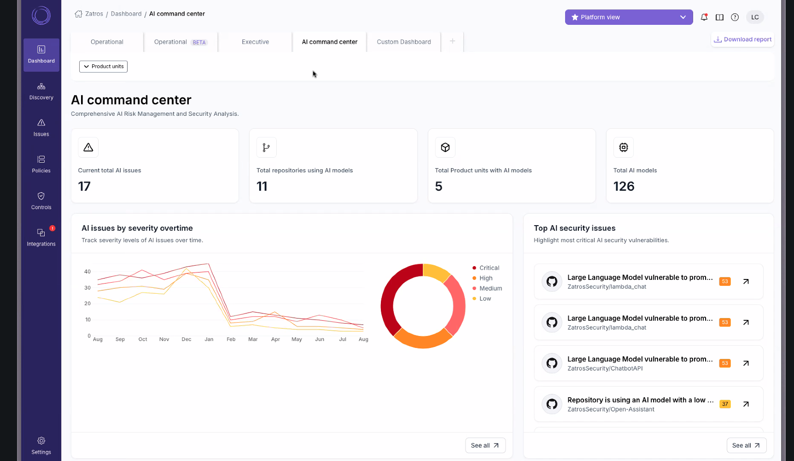
Notes:
Legit Security’s dashboard shows issues at at glance.

Slide 4
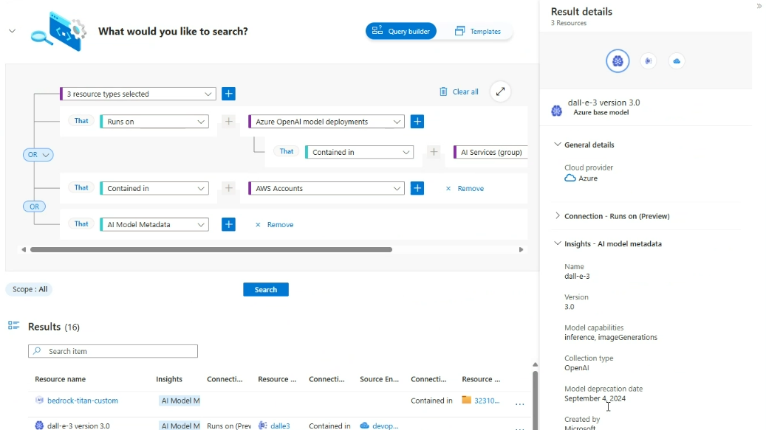
Notes:
Microsoft Defender for Cloud’s search dialog shows how you can drill down and find specific AI abuses

Slide 5
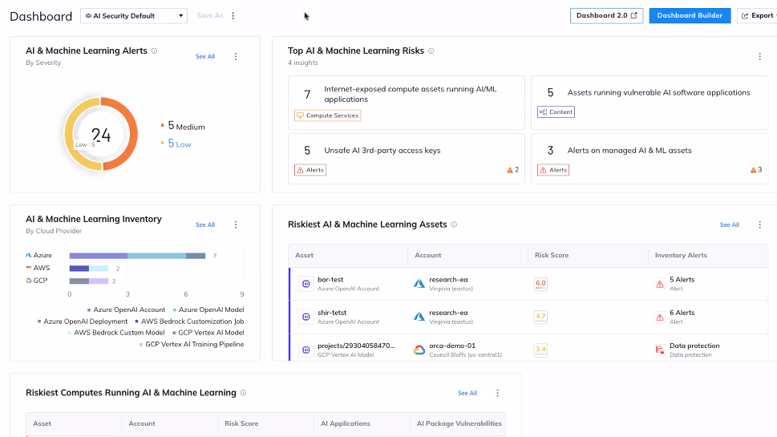
Notes:
Orca Security’s AI dashboard, showing ML inventory, risks and alerts.

Slide 6
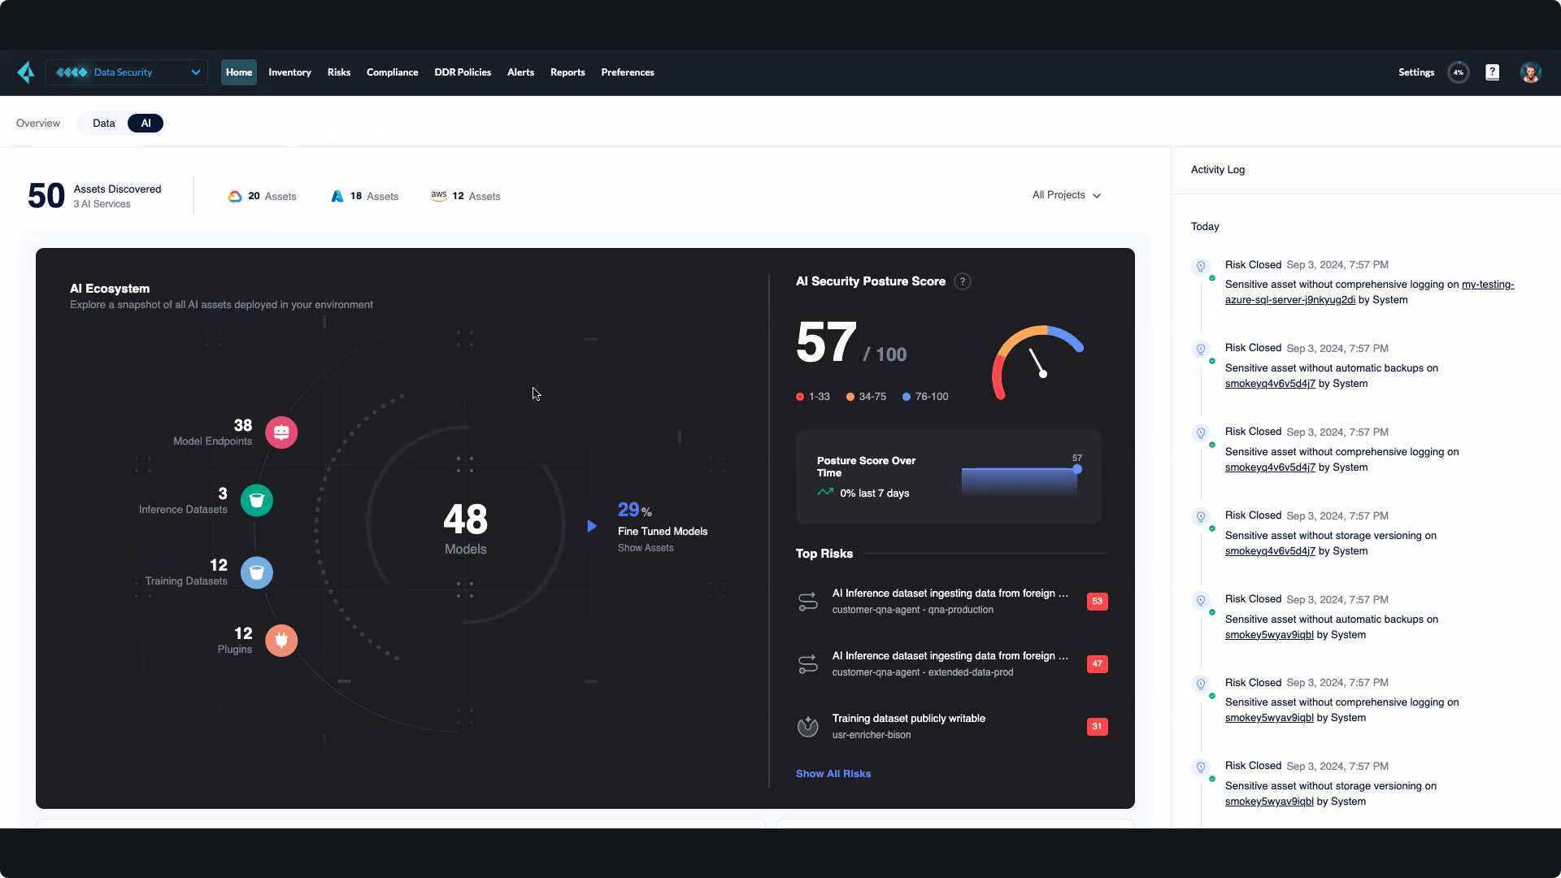
Notes:
Palo Alto Networks Prisma AI-SPM overall dashboard, where you can a posture score and top risks identified.

Slide 7
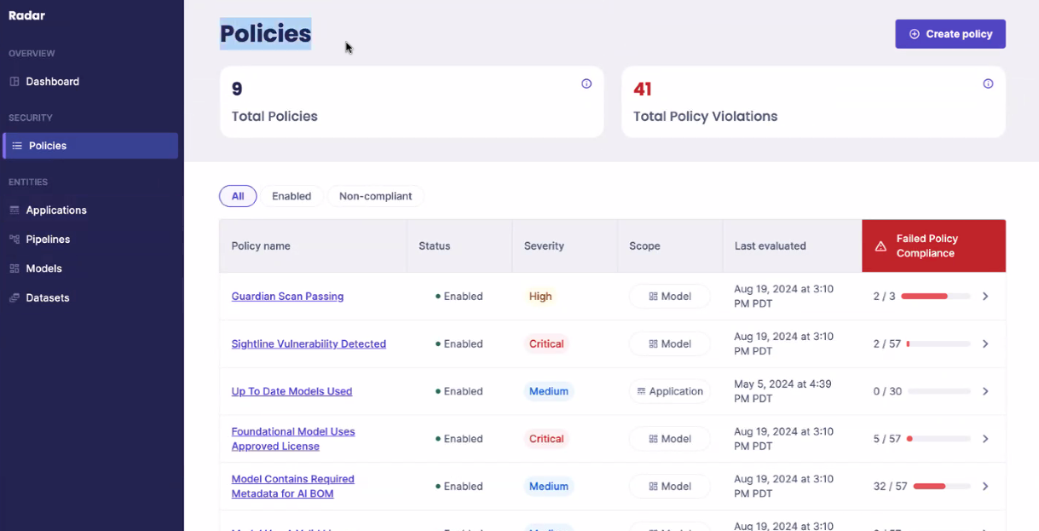
Notes:
ProtectAI Radar’s policy selection screen, showing violations discovered.

Slide 8
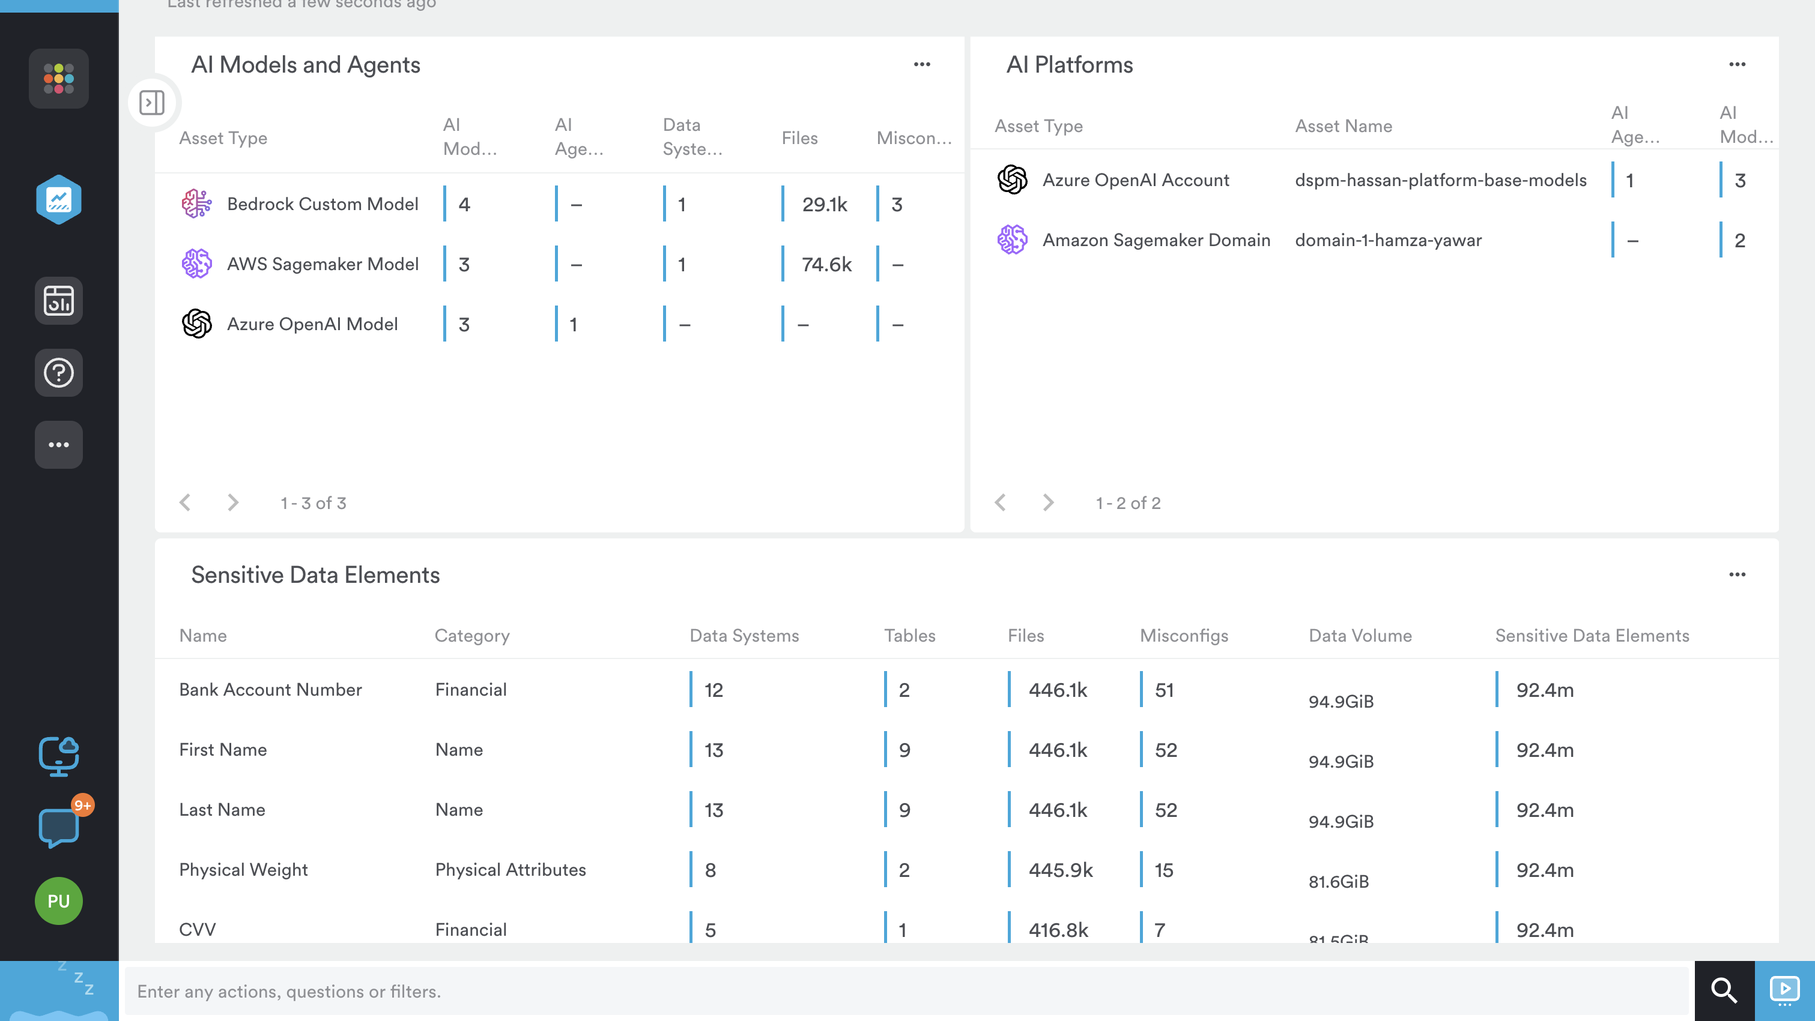
Notes:
Securiti’a AI dashboard, showing discovered models and sensitive data elements.

Slide 9
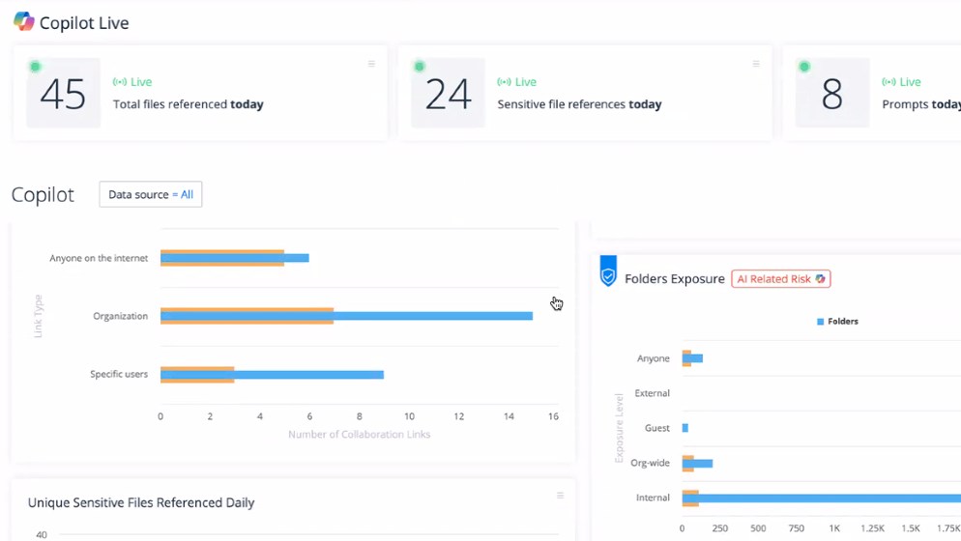
Notes:
Varonis has a specialized dashboard to track Microsoft Copilot security issues.

Slide 10
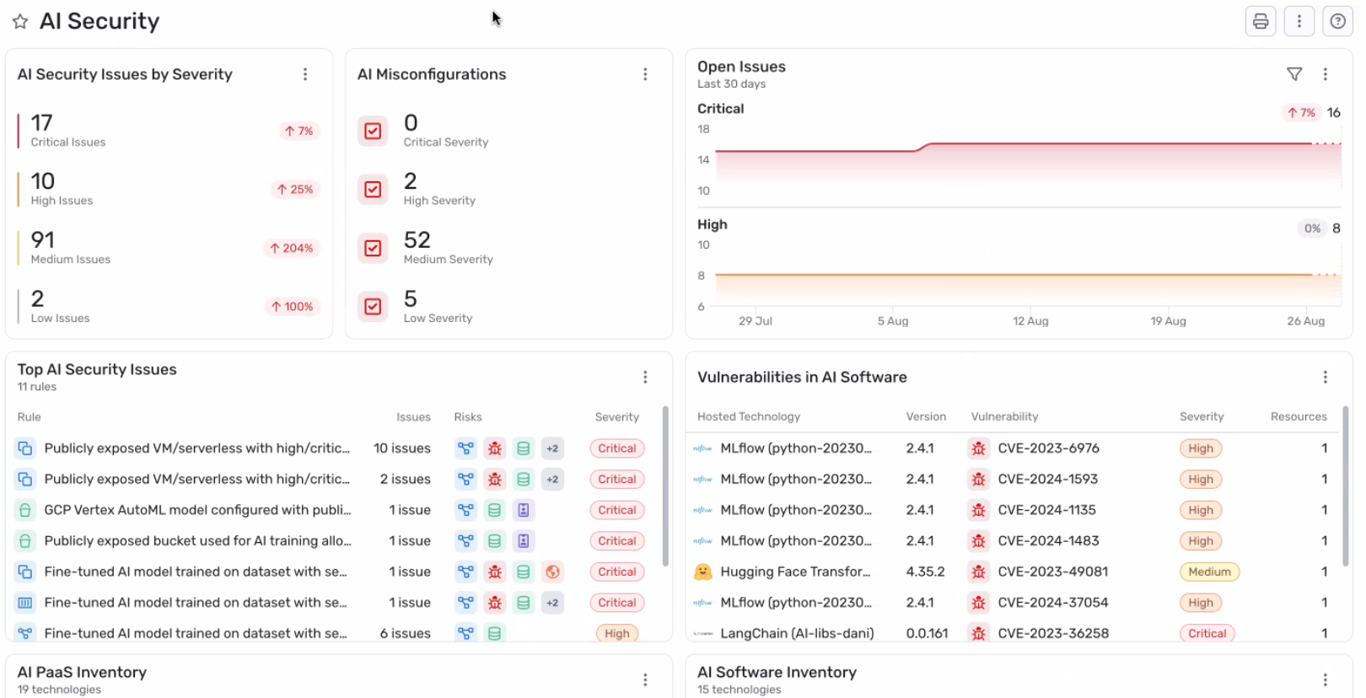
Notes:
Wiz’ AI dashboard, showing security issues, misconfigurations and vulnerabilities.

