Slide 1
Overcoming Fragmented Data:
How the Cloud Data Platform Improves the Customer Experience and Enhances Product Development

Slide 2
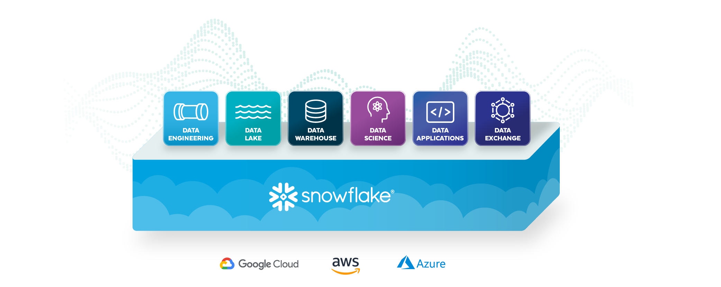
SNOWFLAKE CLOUD DATA PLATFORM
DATA
SOURCES
DATA
CONSUMERS
OLTP DATABASES
ENTERPRISE APPLICATIONS
THIRD-PARTY
WEB/LOG DATA
IoT
DATA MONETIZATION
OPERATIONAL REPORTING
AD HOC ANALYSIS
REAL-TIME ANALYTICS
Notes:
Slide 2

Slide 3
Speaker: David Strom
David Strom is one of the leading experts on network and Internet technologies and has written and spoken extensively on topics such as IT security, VOIP, convergence, email, cloud computing, network management, Internet applications, wireless, and Web services for more than 30 years.
Notes:
David Strom is one of the leading experts on network and Internet technologies and has written and spoken extensively on topics such as IT security, VOIP, convergence, email, cloud computing, network management, Internet applications, wireless and Web services for more than 30 years. He has created numerous print and web publications, built several hands-on IT test labs that mimic actual enterprise situations, curated various email newsletters, blogged extensively about a wide variety of IT business topics for RSA, IBM, HPE, Kaspersky, Avast and other sites, written thousands of magazine articles and published two books: Internet Messaging (Prentice Hall, 1998) which he co-authored with Marshall T. Rose and Home Networking Survival Guide (McGrawHill/Osborne, 2001).
In addition to his editorial work, Strom is also a frequent speaker, panel moderator and instructor at various industry events and trade shows around the world, speaking on a wide range of networking, computer security and Internet communications topics.
He began his career working in varying roles in end-user computing in the IT industry. He has a Masters of Science, Operations Research degree from Stanford University, and a BS from Union College. He lives in St. Louis. His website is strom.com and can be found @dstrom on Twitter.

Slide 4
Today’s Agenda
The demands for better data investments
Centralize and seamlessly share all your data
Make all data actionable and drive real-time insights
Scale up and down easily
Minimize management overhead

Slide 5
New Challenges Ahead
The pandemic has transformed every business into a digital business
More customers shopping online
More staff working from home/remotely
Scaling up a data platform can be tough to meet these new demands
Handling more data
Infrastructure changes across the entire enterprise

Slide 6
Business Implications
Track emerging trends
Locate customers who need more TLC and attention
Work more closely with partners and suppliers

Slide 7
The Evolution of a 360-degree Customer View
An opportunity to improve overall CX
Personalization shouldn’t violate privacy rules or be creepy
Data must be actionable and help this goal
Silos beware!

Slide 8
Steps to Improve Your 360-degree View
Which customers are holding back on their purchases because of staff reductions?
Changes to network infrastructure and security considerations due to more work-from-home population
Ensuring the right systems and applications are in place to support collaboration
Are these the steps? If so, feels a little off, as they are more like use cases or considerations?

Slide 9
Flexibility Has Become Critical
Notes:
Instacart data warehouse migration

Slide 10
The Cloud is Complicated
These trends mean bigger data handling investments
A lot of dependent pieces that must move in a coordinated way
You must know how your plumbing fits together
And how to evolve it to handle these trends to upgrade to more capable platforms.

Slide 11
Do You Really Have All the Necessary Data?
Probably not, but figuring this out takes time
The pandemic changes what is business-critical data
Oopsies – when something gets deleted accidentally – is when you unfortunately have to figure this out

Slide 12
How Data is Organized is Critical
Organizing data to make it truly useful means making it available for analysis
Know the right questions to ask
Determine the reports you need to create
Answer the question: Is this the most current copy of your data?
Ideally, businesses should never have to ask the question if their data is current. It should always be fresh, thanks to concurrent ETL processing

Slide 13
The Purpose of Extraction, Transformation and Loading
Provide deep historical context for businesses
Allow organizations to analyze and report on data more efficiently and easily
Increase productivity as it quickly moves data without requiring the technical skills of having to code it first.

Slide 14
ETL Issues
Extracting data from multiple source systems
Transforming said data to suit business needs
Loading data into a destination database

Slide 15
Single Source of Truth
The landscape changes
Lots of stakeholders who also are changing
Complex relationship of many different data elements
Notes:
This is from Intelliwave Technologies -- https://www.intelliwavetechnologies.com/the-myth-of-the-single-source-of-truth-in-construction-projects/
The problem is that the execution of a SSOT is difficult to achieve because of the complex information systems landscape, large number of stakeholders and fundamental technical challenges, where implementing a SSOT could actually result in hurting a project rather than helping.

Slide 16
The Biggest Enemy: Data Hoarding
Data lake strategies are not inherrently bad, we support those use cases. More that if you can't get the data out to support broader use cases, then your investments aren't delivering value

Slide 17
Separate Storage from Compute Nodes
Legacy data warehouses didn’t always distinguish between the two functions
This made rapid scaling harder, if not impossible, as demands change

Slide 18
The Core Reason: Your Customers
Figure out trends
Satisfy your customers’ demands and changing habits
Offer the best support for all departments of your business
Notes:
. It is like a hotel concierge who can anticipate a guest’s preferences before they even check into the property.

Slide 19
Real-time is the New Floor
This means having real-time data access, using whatever modeling and query tools are needed.
Security and maintenance functions need to be real-time
And data shared with partners too.

Slide 20
How Hulu Created a New Content Bundle

Slide 21
Resolving Channel Conflicts
The age-old fight between selling via the channel and directly to enterprises by tech companies
Remember the 360-degree view?
Learn from the retail world and support omnichannel experience

Slide 22
Key Takeaways
More integrated data infrastructure needed
Real-time needs for variety of user populations
Support a 360-degree customer view
Time to re-evaluate your legacy data technologies

Slide 23
Learn more about Snowflake for Technology companies
www.snowflake.com/data-analytics-for-technology
Notes:
Slide 23:
Links:
https://www.snowflake.com/resource/the-little-book-of-big-success-with-snowflake-technology/
http://www.snowflake.com/data-analytics-for-technology

Slide 24
Thank you!

